Slide 1

Getting Started with
Data Visualization: Tools for Research!
Alison Blaine / Jennifer Garrett
Notes:
Jennifer
Hello Everyone! Thank you so much for coming to this session today.
We want to take a quick moment to INTRODUCE OURSELVES
Alison and I will be leading the session together today.
To talk briefly about this workshop - This is the very first in our brand new series and we are excited to start this. But like anything new, we want and expect these workshops to evolve as we hear feedback from folks like you. Not that you are our guinea pigs, but we want to make sure we are hitting on your needs / concerns. So we expect to be learning a lot just as we hope you do!
After the session we hope that you can spend a few minutes filling out a very short survey.
We will also be passing around a sign in sheet, if you can take a minute to just fill in your name, department, and affiliation (student, faculty, staff) we would really appreciate it.

Slide 2
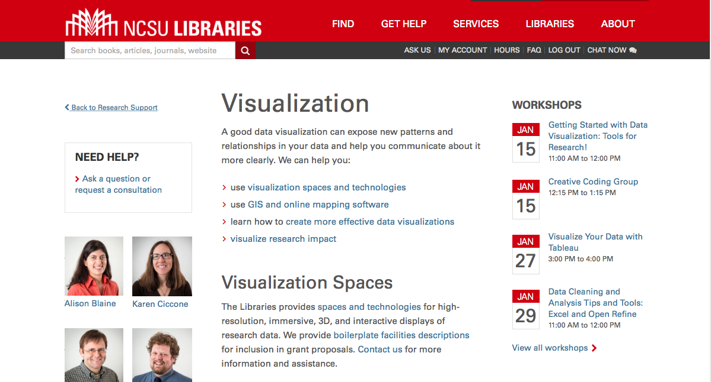
Data Visualization Services lib.ncsu.edu/do/visualization lib.ncsu.edu/do/visualization

Slide 3
Goals
You should leave with:
an understanding of various tools for doing visualization
an understanding of the process for making good visualizations
practice with two tools
If you have questions, please raise your hand!
Notes:
Jennifer
We want to expose you to a variety of tools and also introduce some on the standard process involved when you are considering or starting a visualization, while also giving a good amount of time for practicing with two tools specifically.
Alison will be leading the activity portion of the workshop, while Hannah and I will be circulating the room to answer questions. For instance, if you get behind in the steps or have trouble with your laptop, just raise your hand and one of us will come over. This will just help us maximize the hour.

Slide 4
Data Visualization Process
getting data
getting to know the data
setting goals
determining if a visualization is needed
deciding what to visualize
cleaning
visualizing
designing (potentially re-visualizing it with a different tool)
exporting/embedding
Notes:
Alison

Slide 5
Tools for Getting Started
Plotly
Tableau Public
Raw
Google Fusion Tables
CartoDB (for maps)
Voyant (for text)
Here’s a curated list
Notes:
Jennifer - Because we will share these slides with you, we wanted to add a slide with links to many of the tools we will be covering today.
You can revisit these slides for easy access in the future.
Some of the tools we’ve listed here, we do offer other workshops on. Today we are focusing on Plotly and Raw, but we have workshops that cover Tableau and CartoDB. The tools we have chosen for today are great for quickly visualizing your data. We think this is key to the exploration stage. While there are other tools that maybe look a bit prettier, we chose these tools because you can get ideas on how your data might be visualized (or even if it needs visualization) quickly, with little time invested.

Slide 6
Today’s workshop materials
go.ncsu.edu/startviz

Slide 7
Activity
Step 1: Getting data.
Now, we will go ahead and download the data.
Go to: go.ncsu.edu/startviz
Download the TopBabyNames.csv file to your computer
Notes:
Monica
You can pair up with someone if you want to.

Slide 8
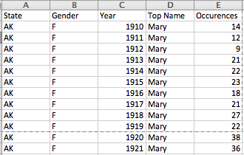
Step 2: Getting to know the data
Observe:
What it’s about
What is being measured?
What don’t you know?
Organization
Are columns and rows organized neatly and uniformly?
Does each cell have one value?
Data types
What types of data are there? Dates, text, numeric?
Do any of those types need to be changed?
Classify the data:
change over time
measurements of different categories (Ex: population rate per county)
geospatial
hierarchical (categories and subcategories)
Notes:
Alison

Slide 9
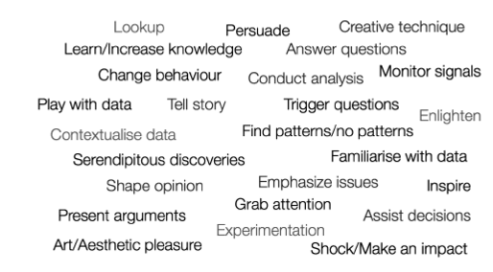
Step 3: Determine your goal
Source: Andy Kirk (2012). Data Visualization: A Successful Design Process, pg.32
Notes:
Alison

Slide 10
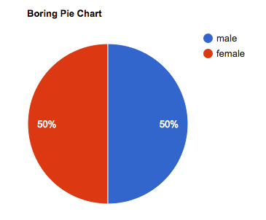
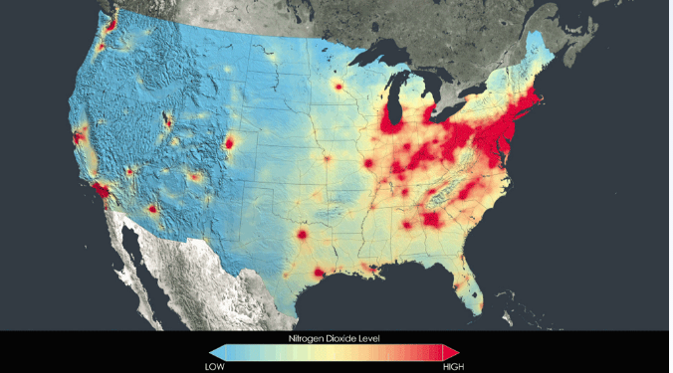
Step 4: Determine if a visualization is needed
Not all data needs to be visualized. Here are some questions to ask yourself:
Can the information be communicated without a visualization?
Do you need people to see patterns quickly from the data?
Source: nasa.gov
Notes:
We talk -- is a vis needed?

Slide 11
Step 5: Cleaning the data
Cleaning data means removing problematic characters, whitespaces, symbols, errors, missing elements and inconsistencies.
Raleigh
Raleigh, NC
Raleigh, N.C.
Raleigh, NC 27695
Raleigh, NC USA
Notes:
Jennifer
The cleaning the data step usually takes the longest and for some, isn’t the most fun. But it’s a very important step and will save you time in the long run.
Cleaning data means removing anything getting in the way of visualizing it using a computer, or modifying raw data in any way. Look for things like trailing spaces (or whitespaces) and other problematic characters. Also look for inconsistencies like those that can often appear in things like addresses.
Or misspellings or alternate spellings that can create problems for analysis.
We are not going to spend time cleaning the data now, but we do have a workshop on this (Data Cleaning and Analysis with Microsoft Excel and Open Refine).

Slide 12
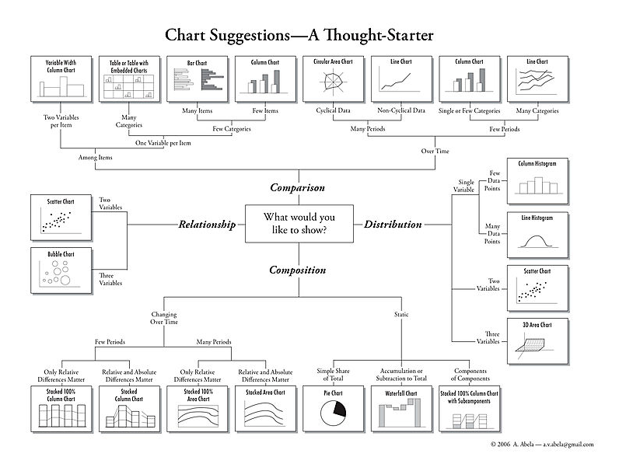
Step 6: Visualizing the Data
Plan the Visualization: Choose chart type!
A. Abela (2009)
Notes:
Monica/Alison

Slide 13
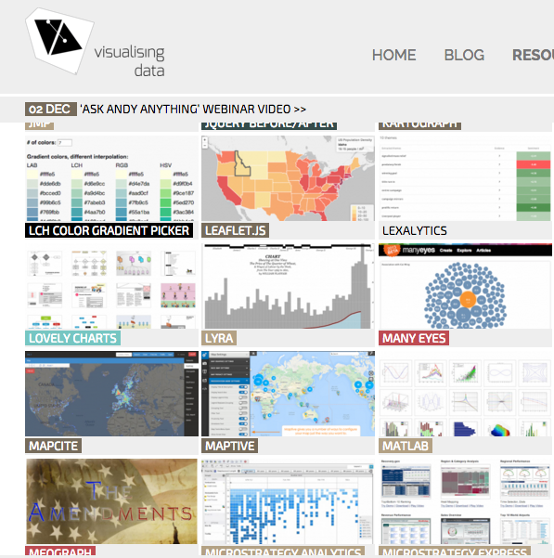
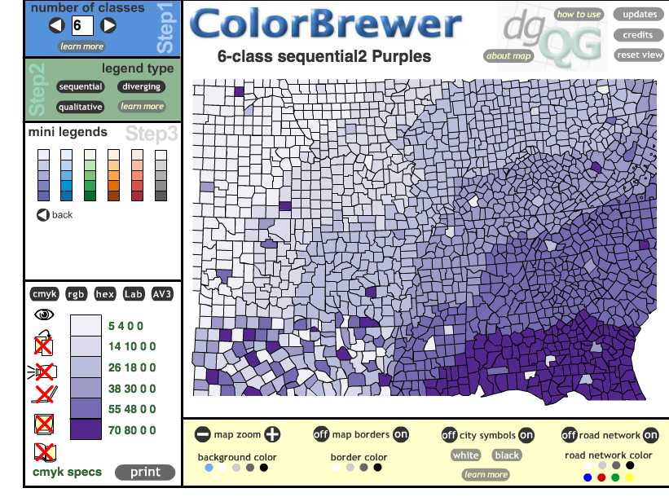
Additional considerations:
Color choice is important.
ColorBrewer: colorbrewer2.org/
Visualising Data:
www.visualisingdata.com/resources
Notes:
And finally this last slide introduce a couple of great online tools that we wanted to share for you should you want to explore later.

Slide 14

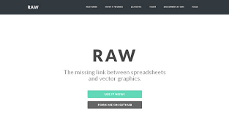
The Tools!

Slide 15
Tableau www.tableau.com
Interactive data visualization and analytics application
Free and paid versions
Tableau Public is free for everyone
Tableau Desktop is free for students (http://www.tableau.com/academic/students)
You can create and share graphs, maps, live dashboards
Notes:
Alison/Monica

Slide 16
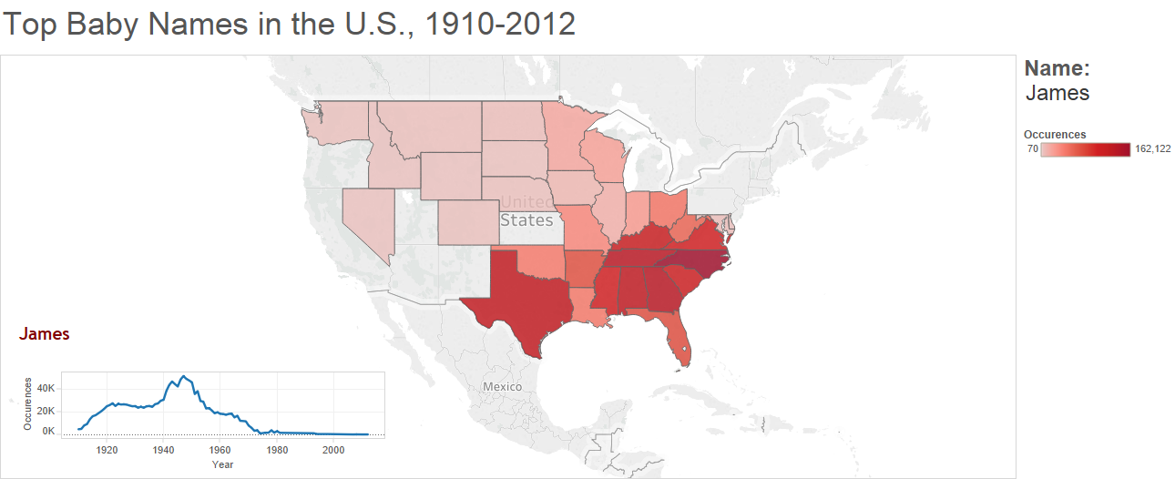
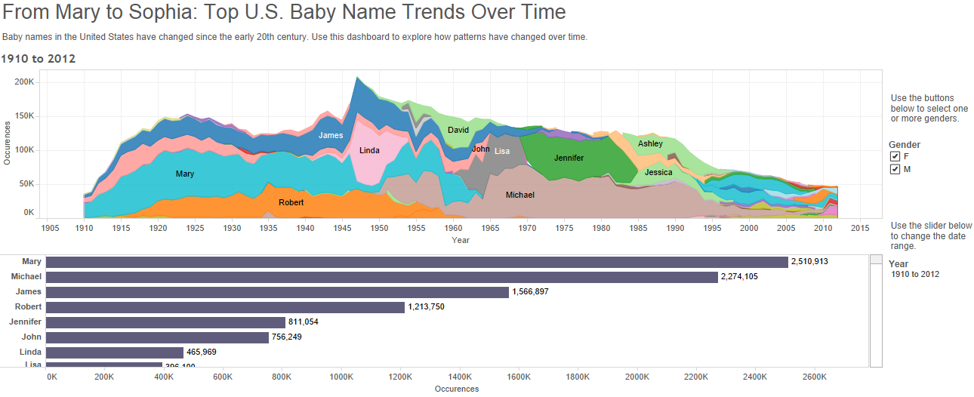
Tableau examples
chart types:
Line
Bar
Map
Flow
dashboards

Slide 17
How to Use Tableau Public
Go to this website and create your own account: public.tableau.com
Download and install the application!
Gallery: public.tableau.com/s/gallery
Notes:
Alison

Slide 18
RAW
app.raw.densitydesign.org
Nice exploration tool
Allows you to make complex chart types
Limited functionality
Data is only in your browser - not stored anywhere
Download: .png, .svg, json

Slide 19
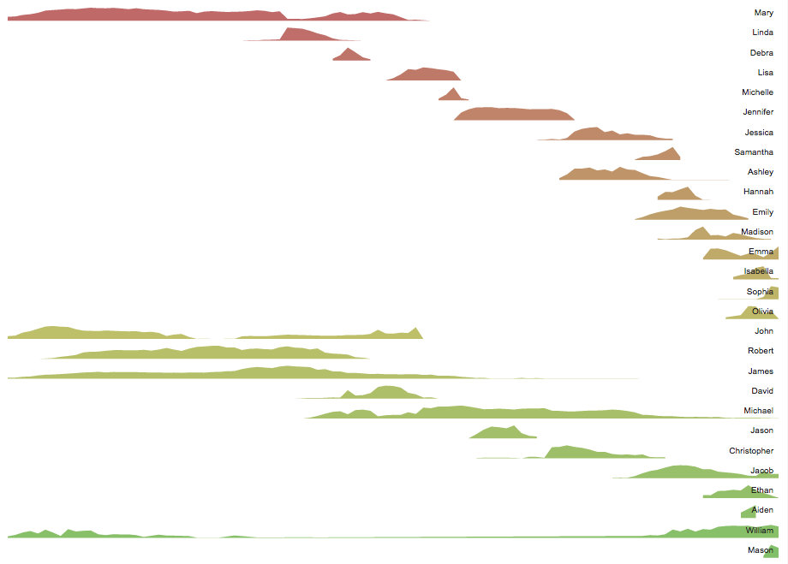
RAW example: small multiples

Slide 20
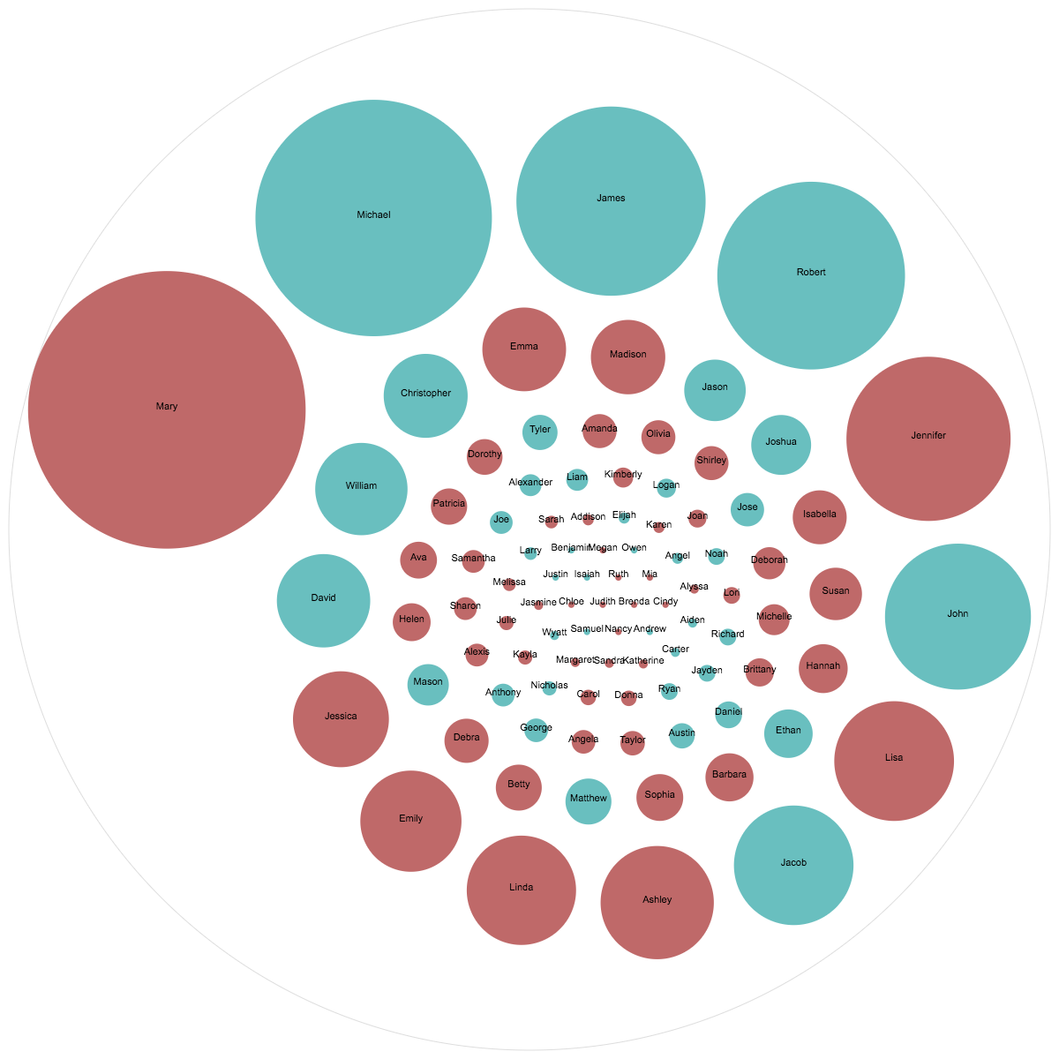
RAW example:
Circle packing
Top Baby Names in US, 1910-2012

Slide 21
Contact: Alison Blaine
ablaine@ncsu.edu

